Slide 1
4 – Scenarios
Detail Visual Analysis

Slide 2
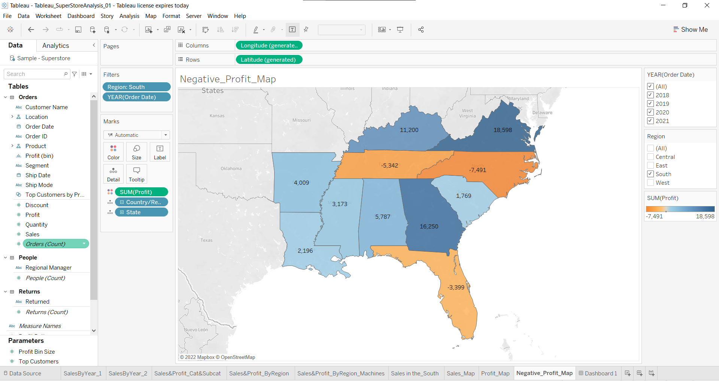
Duplicate the profit map and rename the Negative profit map.

Slide 3
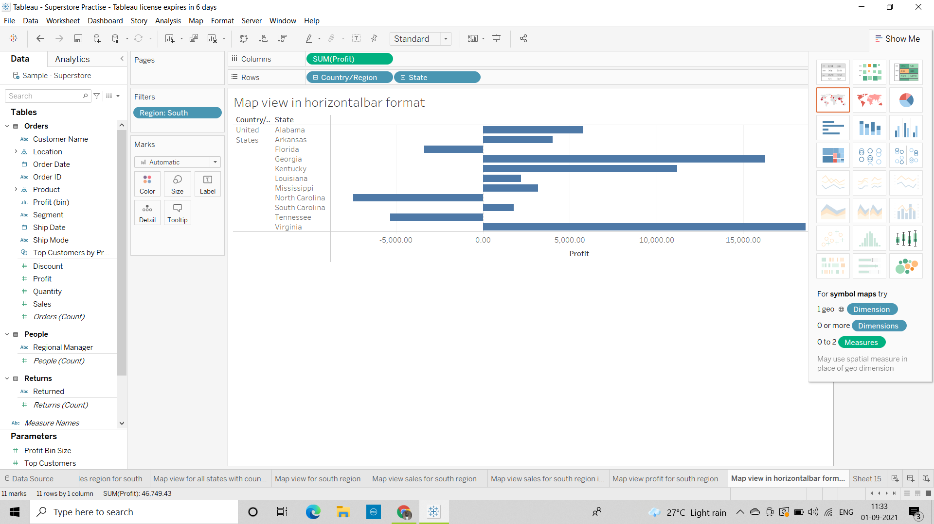
1) Represent the profit map in horizontal bar format.

Slide 4
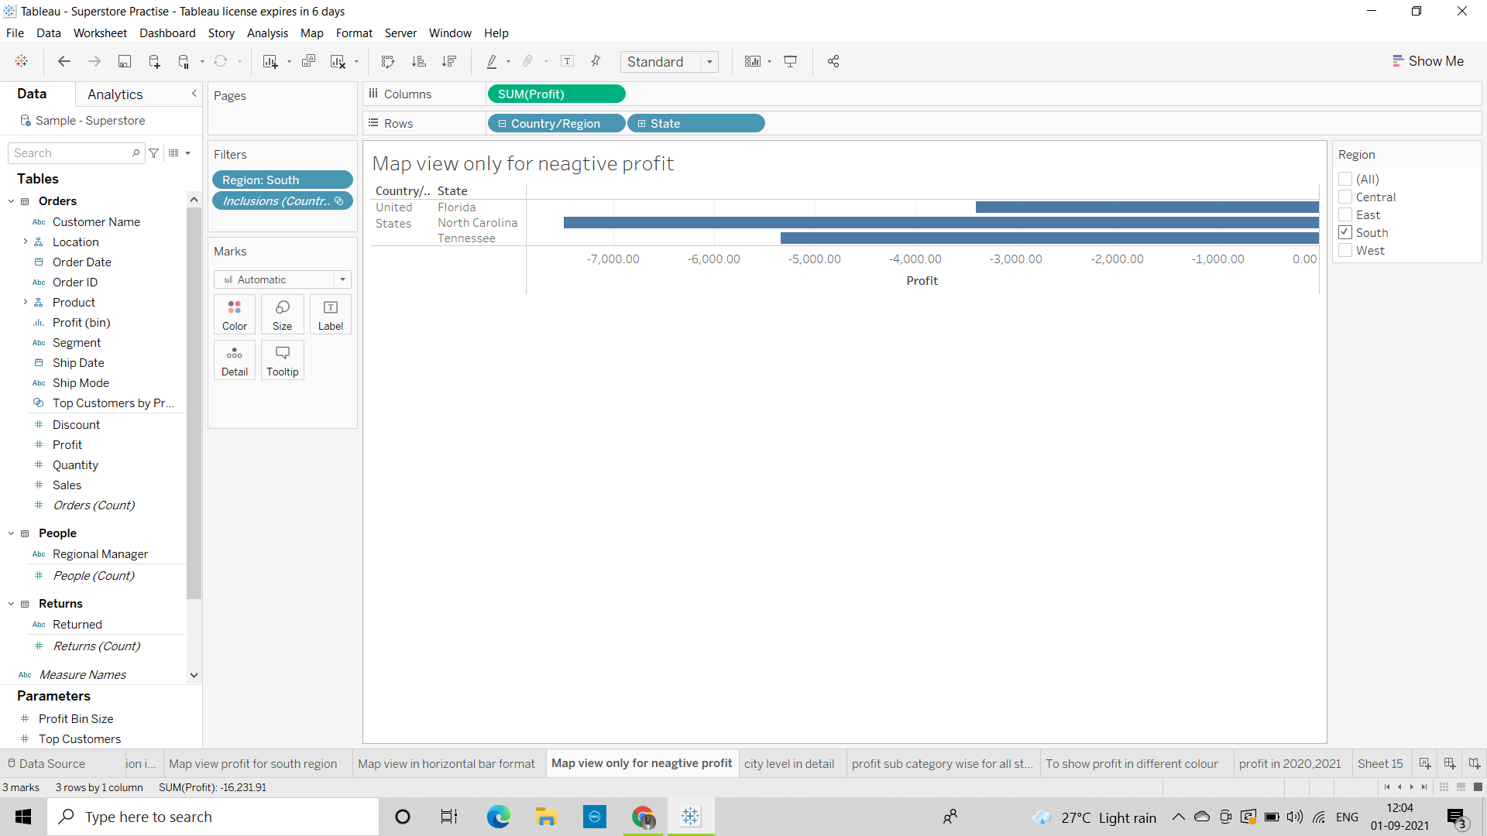
2) Show only the states having negative profit in the bar graph.

Slide 5
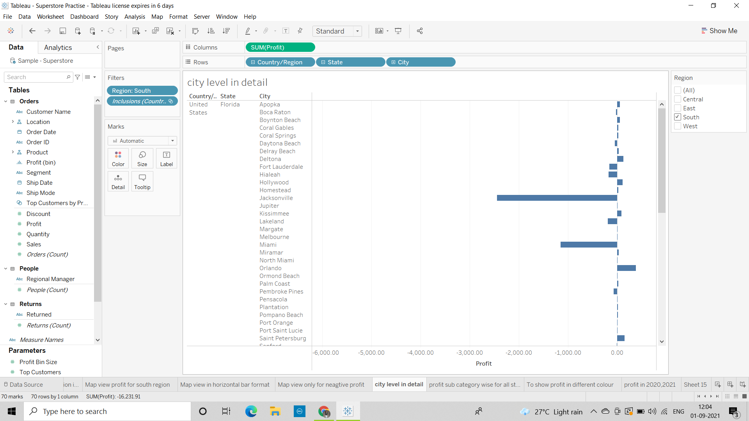
3) On the Rows shelf, click the plus icon on the State field to drill-down to the City level of detail.

Slide 6
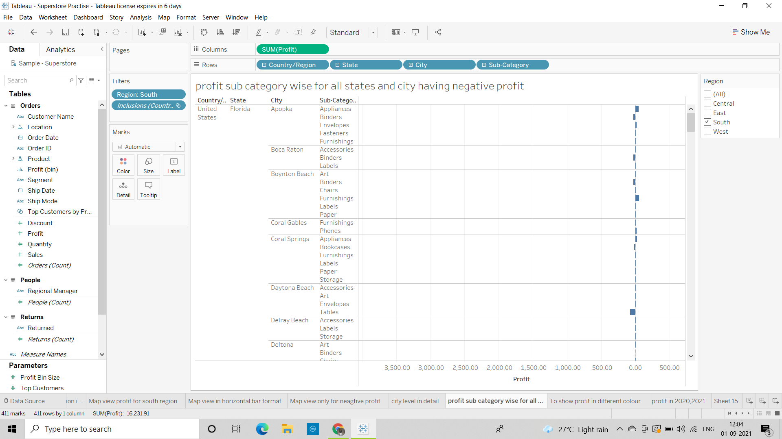
4) Show profit subcategory wise for all the states and city having negative profit.

Slide 7
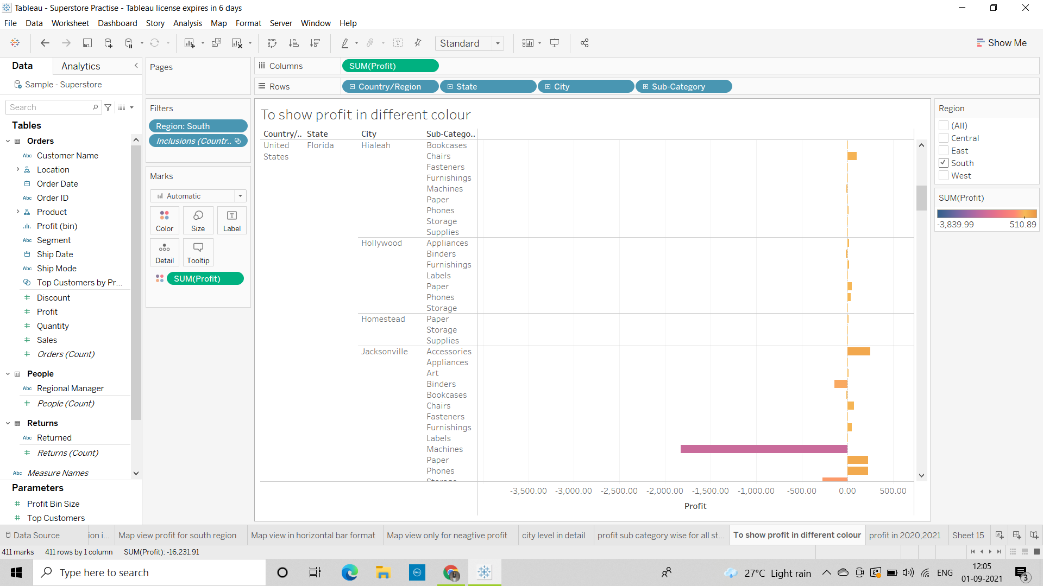
5)Show the profit in different colour.

Slide 8
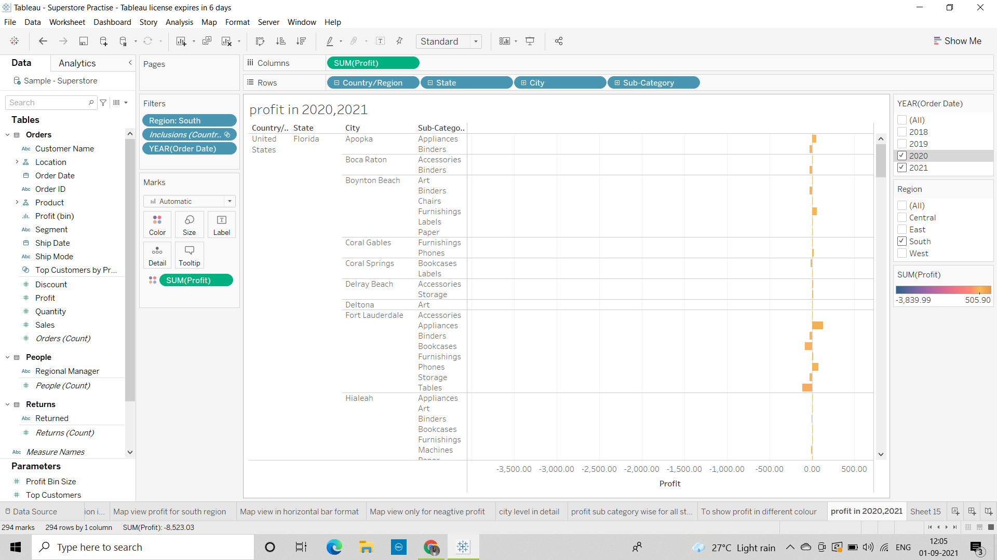
6) Check the profit in 2020 & 2021.

Slide 9
7)Find some meaningful information and suggest how can we increase the profit.
We need to focus on the sub categories which are showing highest negative profit.
In Florida state Jacksonville city for tables sub category it is showing
(-1045) profit we need to improve it in the coming year
In North Carolina state for Burlington city there are 3 sub categories which are showing highest negative profit
In Tennessee state for Knoxville city tables sub category there is a negative profit and for Memphis city it is showing negative profit for Binders sub category.

